Slide 1
Using Pointers with Classes

Slide 2
Agenda
Understanding Pointers
Pointers Variables and Declarations
Pointers Operators
Builtin Arrays
Const Pointer
Accessing Class Members using Pointers
Understanding this Pointer

Slide 3
What are Pointers?
Pointer Variable contains memory address as their value.
Normal Variable contains a specific value., e.g. int x =5, value of x is 5.
Pointer contains the memory address of that variable, which contains that value.
Variable references a value directly.
Pointer references a value indirectly
Referencing a value through a pointer is called indirection.

Slide 4
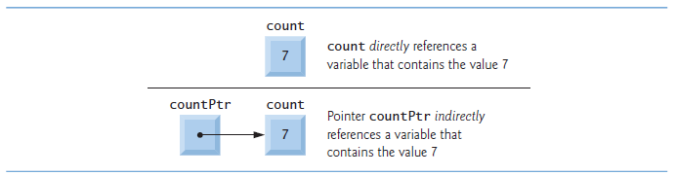
Pointer Visualization

Slide 5
Declaring Pointer
Pointer variables need to be declared, before using them.
The following diagram below shows, how to declare a pointer
Declares the variable countPtr to be of type int * (i.e., a pointer to an int value) and is
read (right to left), “countPtr is a pointer to int.”
But count variable is a normal int type variable, not a pointer.

Slide 6
Declaring Pointer
Each variable being declared as a pointer must be preceded by an asterisk (*).
In the diagram below, xPtr and yPtr are pointers to double values.
When * appears in a declaration, it’s not an operator; rather, it indicates that the variable being declared is a pointer.
Pointers can be declared to point to objects of any data type.

Slide 7
Initializing Pointers
Pointers should be initialized to nullptr (new in C++11) or an address of the corresponding type either when they’re declared or in an assignment.
A pointer with the value nullptr “points to nothing” and is known as a null pointer.
In versions prior to C++ 11, value specified to null pointer was 0 or NULL.

Slide 8
Pointer Operators
Address (&) Operator
Unary operator, that obtains the memory address of it’s operand.
The statement above assigns the address of the variable y to the pointer yPtr.
Variable yPtr is “pointing to y”.
Variable yPtr “indirectly” references to “value of y”
&y is the address operator.

Slide 9


Graphical Representation
The operand of the address operator must be an lvalue—the address operator cannot be applied to constants or to expressions that result in temporary values (like the results of calculations).

Slide 10
Indirection (*) Operator
The unary * operator is referred to as the indirection operator or dereferencing operator
Returns an lvalue representing the object to which its pointer operand points.
The following statement would display the value of variable 5
Similar to the below statement
Using * in this manner is called dereferencing a pointer
Dereferenced Pointer can also be used on the left hand side of the assignment statement

Slide 11
Dereferenced pointer may also be used to receive an input value
Would place the input value in y.

Slide 12
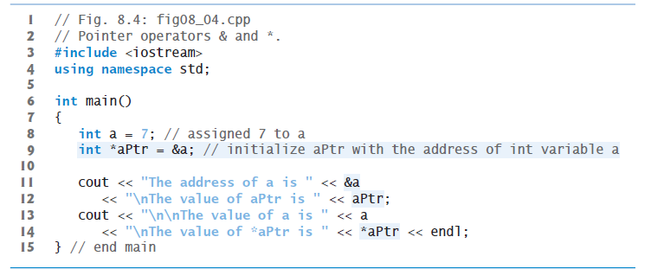
Code Demonstration

Slide 13
Pass by Reference using Pointers
Arguments to a function can be passed using reference parameters.
The called function modifies the original values of the arguments in the caller
Reference parameters also enable programs to pass large data objects to a function and avoid the overhead of passing the objects by value (which, of course, copies the object).
Pointers, like references, also can be used to modify one or more variables in the caller or to pass pointers to large data objects to avoid the overhead of passing the objects by value.

Slide 14
Pass by References using Pointers
By using pointers and the indirection operator (*) accomplish pass-by-reference can be accomplished.
When function is called with an argument that has to be modified, address of the argument is passed.
This is normally accomplished by applying the address operator (&) to the name of the variable whose value will be modified.

Slide 15
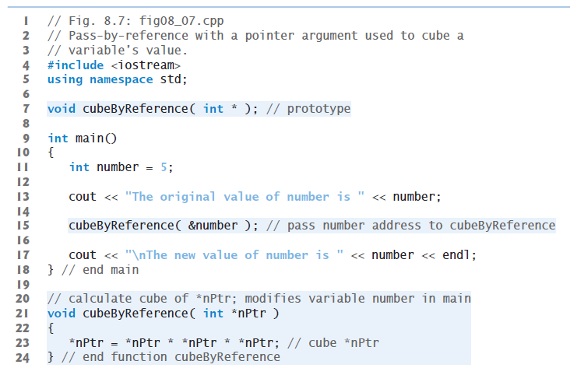
Pass by Reference Code Demonstration

Slide 16
Built-In Arrays
Fixed-Size Data Structures
Declaration Syntax include type of element and number of elements, which needs to be stored in the built-in array.
Compiler reserves appropriate amount of memory.
arraySize must be an integer greater than zero.

Slide 17
Built in Array Limitations
• They cannot be compared using the relational and equality operators—you must use a loop to compare two built-in arrays element by element.
• They cannot be assigned to one another.
• They don’t know their own size—a function that processes a built-in array typically receives both the built-in array’s name and its size as arguments.
• They don’t provide automatic bounds checking—you must ensure that array-access expressions use subscripts that are within the built-in array’s bounds.

Slide 18
Const Pointer
Const keyword informs the compiler that the value of a particular variable should not be modified
Consider a function that takes a pointer to the initial element of a built-in array and the array’s size as arguments and subsequently displays the built-in array’s elements. Such a function should loop through the elements and output each individually. The built-in array’s size is used in the function’s body to determine the highest subscript so the loop can terminate when the displaying completes. The size does not need to change in the function body, so it should be declared const to ensure that it will not change. Because the built-in array is only being displayed, it, too, should be declared const. This is especially important because built-in arrays are always passed by reference and could easily be changed in the called function. An attempt to modify a const value is a compilation error.

Slide 19
Passing pointers to functions
Four ways to pass a pointer to a function:
a non constant pointer to non constant data
a non constant pointer to constant data
a constant pointer to non constant data
a constant pointer to constant data
Each combination provides a different level of access privilege.

Slide 20
Non Constant Pointer to Non Constant Data
The highest access is granted by a non constant pointer to non constant data
The data can be modified through the dereferenced pointer, and the pointer can be modified to point to other data.
Such a pointer’s declaration (e.g., int *countPtr) does not include const.

Slide 21
Non Constant Pointer to Constant Data
This type of pointer can be modified to point to any data item of the appropriate type, but the pointer cannot modify the data to which it points
Such a pointer might be used to receive a built-in array argument to a function that should be allowed to read the elements, but not modify them.
Any attempt to modify the data in the function results in a compilation error.

Slide 22
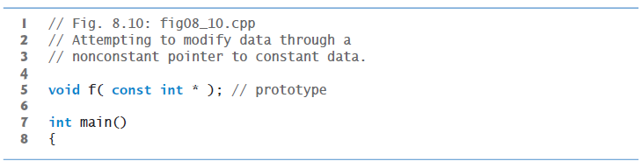
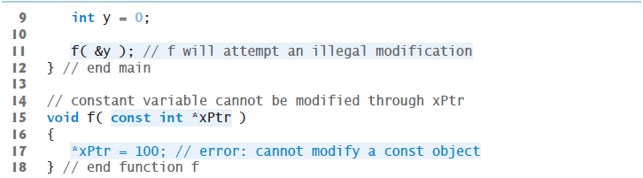
Non Constant Pointer to Constant Data - Code Example

Slide 23
Constant Pointer to Non Constant Data
A pointer that always points to the same memory location
Data at that location can be modified through the pointer.
Pointers that are declared const must be initialized when they’re declared.
But if the pointer is a function parameter, it needs to be initialized with the pointer that’s passed to the function.

Slide 24
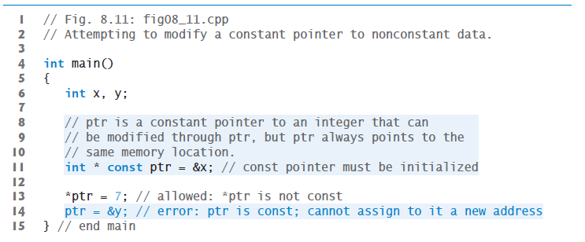
Constant Pointer to Non Constant Data - Code

Slide 25
Constant Pointer to Constant Data
This type of pointer always points to the same memory location
The pointer cannot modify the data at that location.
Has the minimum access privilege
Built-in array should be passed in this manner to the function

Slide 26

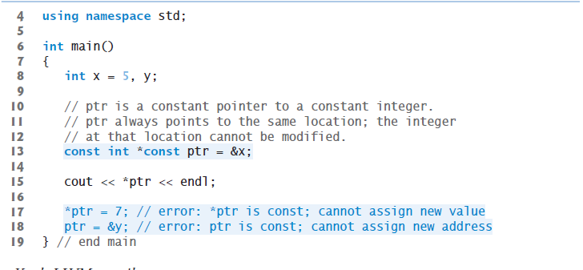
Constant Pointer to Constant Data - Code

Slide 27
Sizeof Operator
Compile time Unary Operator.
Determines the size of built-in array or any other data type, variable or constant, during program compilation.
When applied to a built-in array’s name, the sizeof operator returns the total number of bytes in the built-in array as a value of type size_t.
Can be applied to any expression or type name.
When sizeof is applied to a variable name (which is not a built-in array’s name) or other expression, the number of bytes used to store the specific type of the expression is returned.
sizeof’s operand is not evaluated as it is a compile time operator.

Slide 28
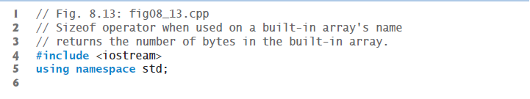
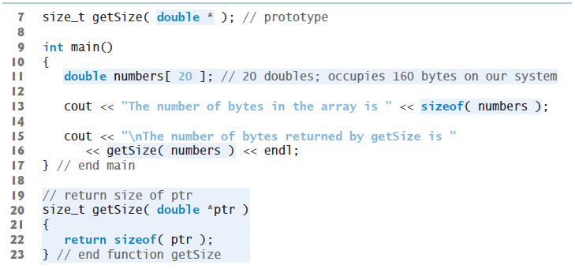
Sizeof Operator Code Demo for Built-in Array.

Slide 29
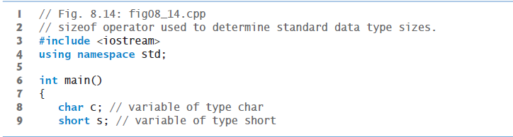
Determining sizeof built-in types

Slide 30
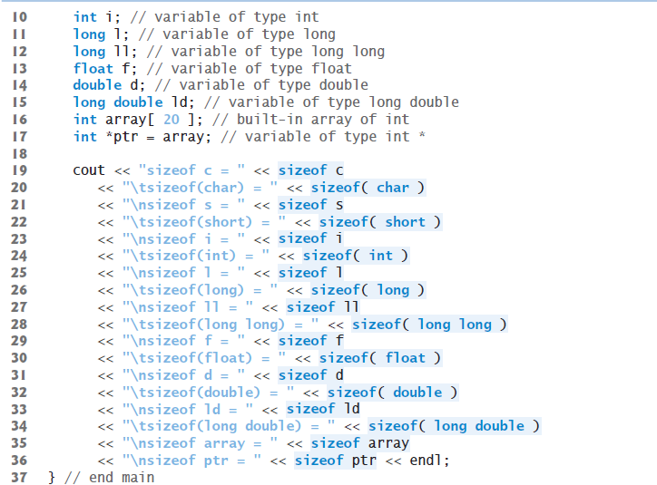

Slide 31
Pointer Expressions and Arithmetic
Pointer allows few arithmetic operations.
Pointer can be incremented (++) or decremented (--).
An integer can be added to or subtracted from a pointer.
One pointer may be subtracted from another of the same type
[ This particular operation is appropriate only for two pointers that point to elements of the same built-in array.]

Slide 32
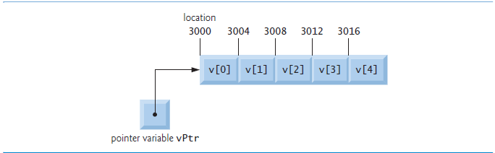
Understanding Pointer Arithmetic

Slide 33
Adding integers to and subtracting from Pointers
When an integer is added to, or subtracted from, a pointer, the pointer is not simply incremented or decremented by that integer.
Instead, the arithmetic involves shifting the bytes
The number of bytes depends on the object’s data type.
vPtr points to memory location 3000, in the beginning.
Addition of integer 2, would shift the location of vPtr with 8 bytes, as integer is of 4 bytes
The above arithmetic would be performed as
vPtr = 3000 + 2 * 4 = 3008

Slide 34
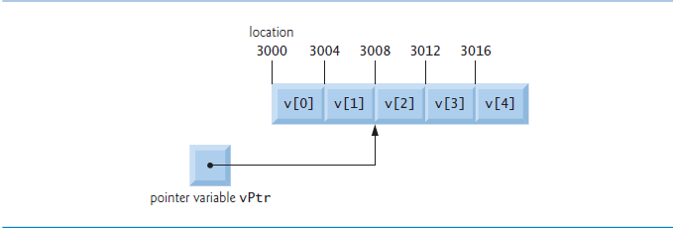
Adding integers to and subtracting from Pointers
vPtr would now be pointing to memory address 3008, which happens to be vPtr[2] ,or the third element in the array

Slide 35
How Pointers and Class work together
For a Person class, which has a method setName and an object person1, we can access the member function, either by using (.) operator with the object reference or (->) with pointer.
The following piece of code describes how to do it:
Person person1; //Person object
// personRef refers to Person’s object
Person &personRef = person1;
// personPtr points to Person’s object
Person *personPtr = &person1;
We can invoke the member function setName by using (.) operator and (->) pointer as follows:
person1.setName(“I am the actual object”);
personRef.setName(“ I am the referred object “);
personPtr -> setName(“ I am the pointed object “);

Slide 36
this pointer
In C++, every object of a class has access to it’s own memory address through a special pointer named “this”
Member functions use the this pointer implicitly or explicitly to reference an object’s data members and other member functions
“this” pointer can be used explicitly to avoid naming collisions.

Slide 37
this pointer code
int main()
{
Person bob;
cout << "Called from main ->" << &bob<<endl;
cout << "Called from getAddress -> " << bob.getAddress() << endl;
Person john;
cout << "Called from main ->" << &john << endl;
cout << "Called from getAddress -> " << john.getAddress() << endl;
}
class Person
{
public:
Person *getAddress();
};
Person * Person::getAddress()
{
return this;
}

Slide 38
this pointer - Avoid naming collision
this pointer can be used explicitly to avoid naming collision.
In our person class, we have a data member called name
Class Person
{
private:
string name;
Public:
Void setName(string);
}
Void Person::setName(name)
{
name = name;
}
Compiler would see this as an error, because it is not able to resolve, which name variable to use.
This problem can be resolved by using this keyword.
Void Person::setName(name)
{
this->name = name;
}

